Slide 1
E-HUT
An Advance E-commerce Project

Slide 2
Group Information
sr | Name | Id | Email | Phone
1 | Borno, Md. Sirajuddin | 18-36449-1 | bornoahmed2@gmail.com | 01704992725
2 | Hossain, Muntasir | 18-36421-1 | muntasirhosain@gmail.com | 01788075438
3 | Abdullah, Syed | 18-36537-1 | syed_khoab@outlook.com | 01744-641522
4 | Faisal, Mahbub Hossain | 18-37337-1 | mahbubhossain249@gmail.com | 01966272734

Slide 3
Motivation
Mainly in Dhaka city where people are doing their job and can’t find enough time to go to the grocery store every week to buy their groceries. Who goes shopping most of the time goes without a proper shopping list and spends more than they need. So our main purpose is to provide them the service where they can get their necessary groceries from their homes. Our service also will restrict them from over spending. They will only spend the amount of money for their groceries that they can afford. So by doing these they can save their valuable time and also they don’t need to worry about if they are wasting their money in drossy groceries because we will also ensure them by providing quality grocery products.

Slide 4
INTRODUCTION
This project is about to study and design a web application that will provide services to busy families. Deliver products within fixed days of weeks and in a time range. Deliver fresh vegetables and groceries regularly. This project is carried out to build a web based e-commerce application from scratch. This will be built to provide service to the customers to get their needful day to day groceries. The system will provide a suggestion of a grocery list based on their budget that will be for a month. They will be able to order their needs and they can also customize their orders. They don't need to go outside to purchase their groceries, they can just order from the website. Customers will provide their preferred order receive date and time and the system will automatically place orders for the customers. If the customers want they can also change their preferences time and date and they will also have the authority to cancel their order at any time.

Slide 5
System Features
Admin:
▪-Login
▪-Add new admin and managers
▪-View Retailer and delivery man information
▪-View customer information
HR Manager:
-Login
▪-Retailer verification
▪-Delivery man verification

Slide 6
System Features
Accounting and Finance:
▪-Login
▪-Manage Income and expenditure
Unregistered User:
▪-See/search contents (groceries)
▪-Check availability of products
▪-See available offers.

Slide 7
System Features
Customer:
▪-Login
▪-View product
• -By shop
• -By category
• -Search
• -Sort
• -Suggestion List
▪-Grocery suggestion list
▪-Add to cart

Slide 8
System Features
Customer:
-Checkout
• -Make payment (Mobile banking, Card) once in a month
•-View balance (adjustment with previous balance)
•-Service cancelation (Entirely)
▪-Order Cancelation (Weekly/Monthly)
▪-Feedback on product and delivery service (optional)
▪-Discounts/Voucher/Referrals
▪-View stats (Monthly, Category)

Slide 9
System Features
Retailer:
▪-Self-Registration
▪ -Retailer info
• -Shop name
•-Shop Address
•-Bank account information
•-Verification
▪-Add/Update/Disable Product
▪-Discount/Voucher
▪-View Review and ratings
▪-Update delivery information

Slide 10
System Features
Delivery Man:
-Self-Registration
▪-Verification
▪-Login
▪-View nearest order
▪-Accept order
▪-Update delivery process
▪-View Stats
▪-View Review and ratings
Payment:
▪-Keeping log of all transaction history.
▪-Individual client wise payment module.
▪-Security and authentication verification of payment cards.

Slide 11
Environments
The system will be created under windows operating system environment. It will work as a middleware between the software and the operating system.The hosting server has a 99.9% uptime. This website is platform independent.So this will work in every platform like windows, Linux and MacOS. This website will be available in a variety of browsers including Chrome, Mozilla Firefox, Microsoft Edge, Opera, and others. This is a web application in which client program includes browser-based user interfaces while the major component of the website is hosted on a Linux server.

Slide 12
Benefits
-No hassle for buying groceries.
▪-Customers will set their monthly budget and the system will provide a suggestion list of groceries.
▪-Customers don't have to go outside to get their groceries.
▪-Customers don't need to spend time thinking about grocery shopping.
▪-It prevents customers from overspending on groceries.
▪-Customer satisfaction.
▪-Save time and travelling cost.
▪-Very safe and secure payment system.
▪-Multiple option for doing payment.
▪-Every transaction history is recorded.

Slide 13
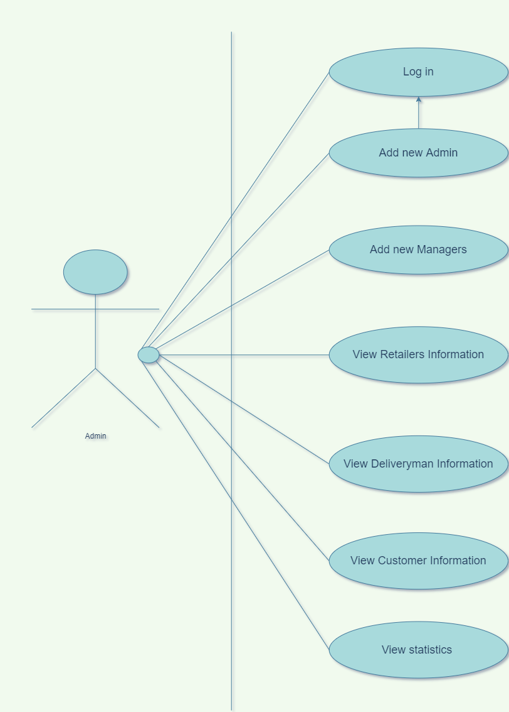
Use Case Diagram
-Admin

Slide 14
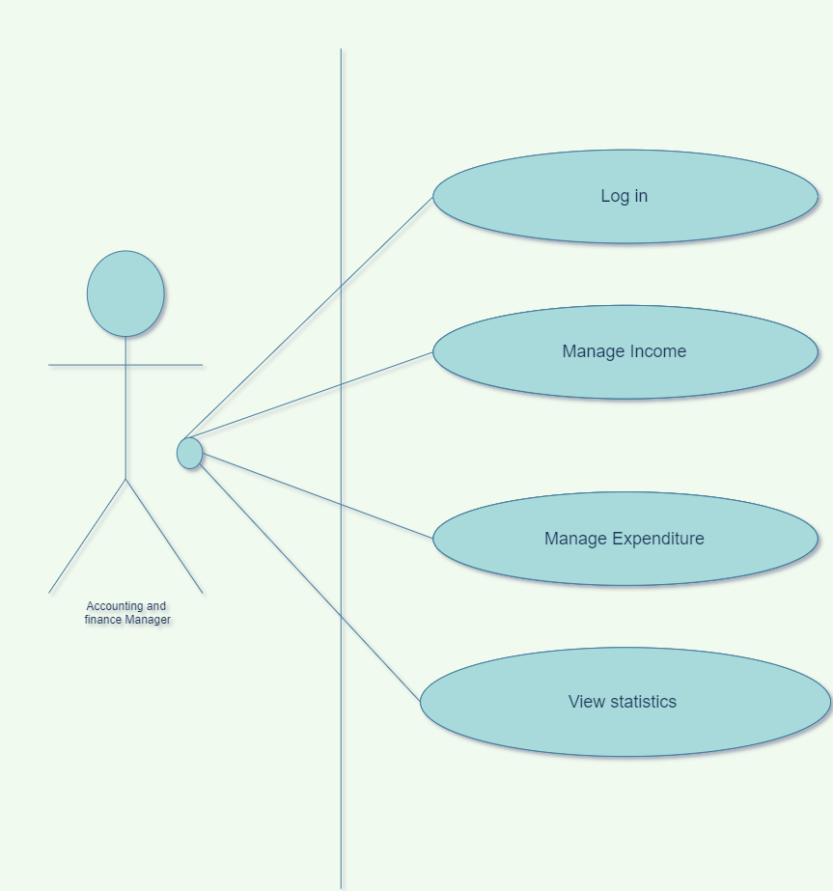
Use Case Diagram
-Finance and Accounting Manager

Slide 15
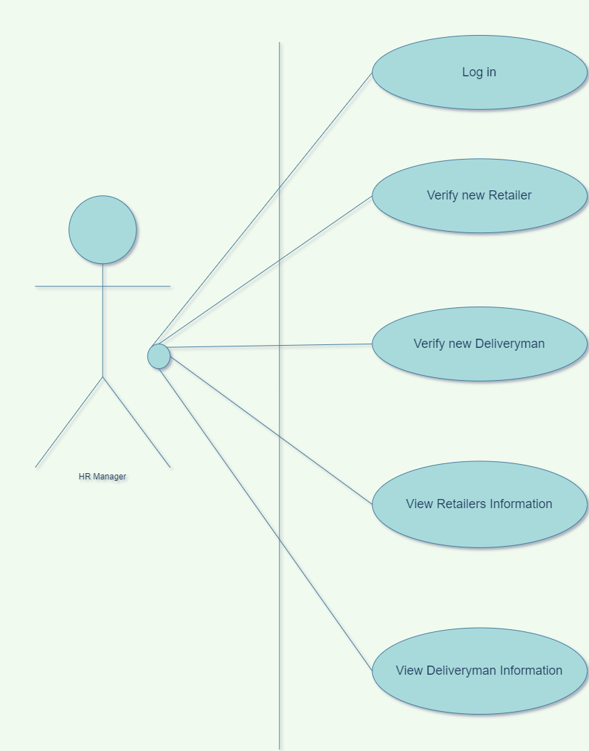
Use Case Diagram
-HR Manager

Slide 16
Use Case Diagram
-HR Manager

Slide 17
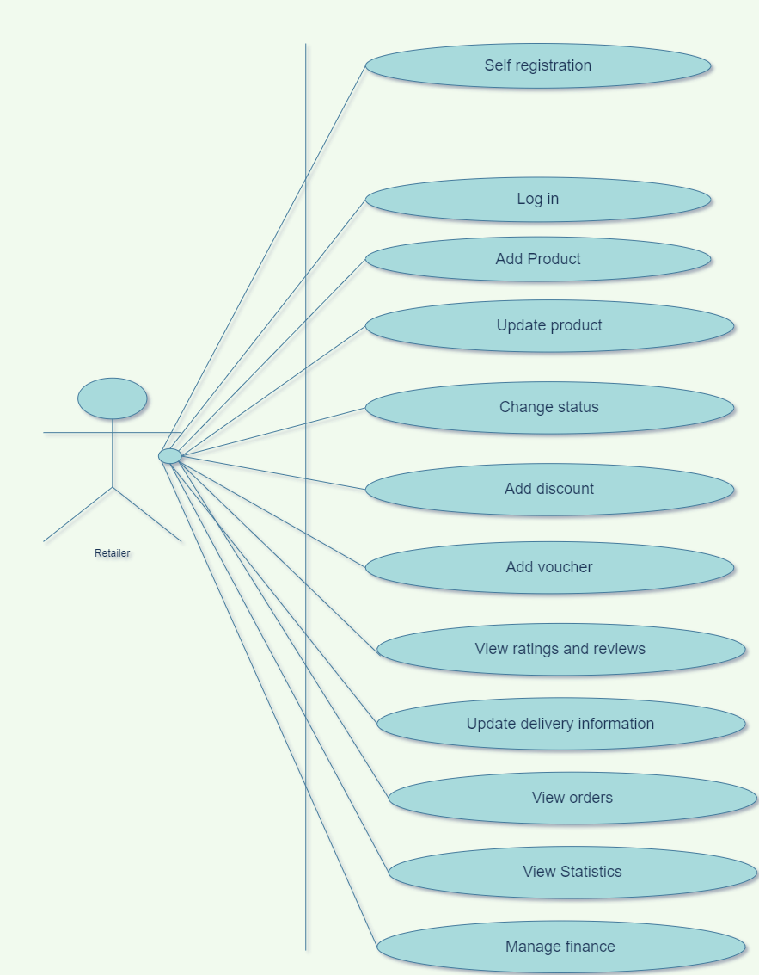
Use Case Diagram
-Retailer

Slide 18
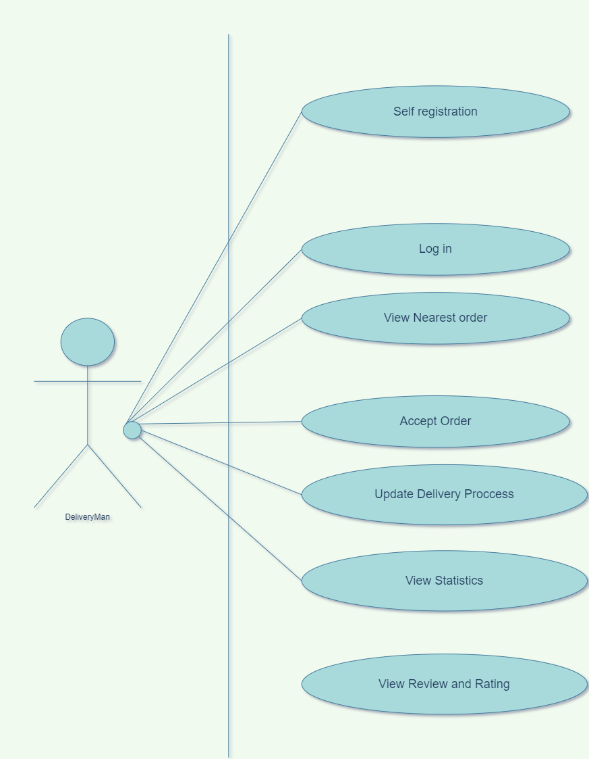
Use Case Diagram
-Delivery Man

Slide 19
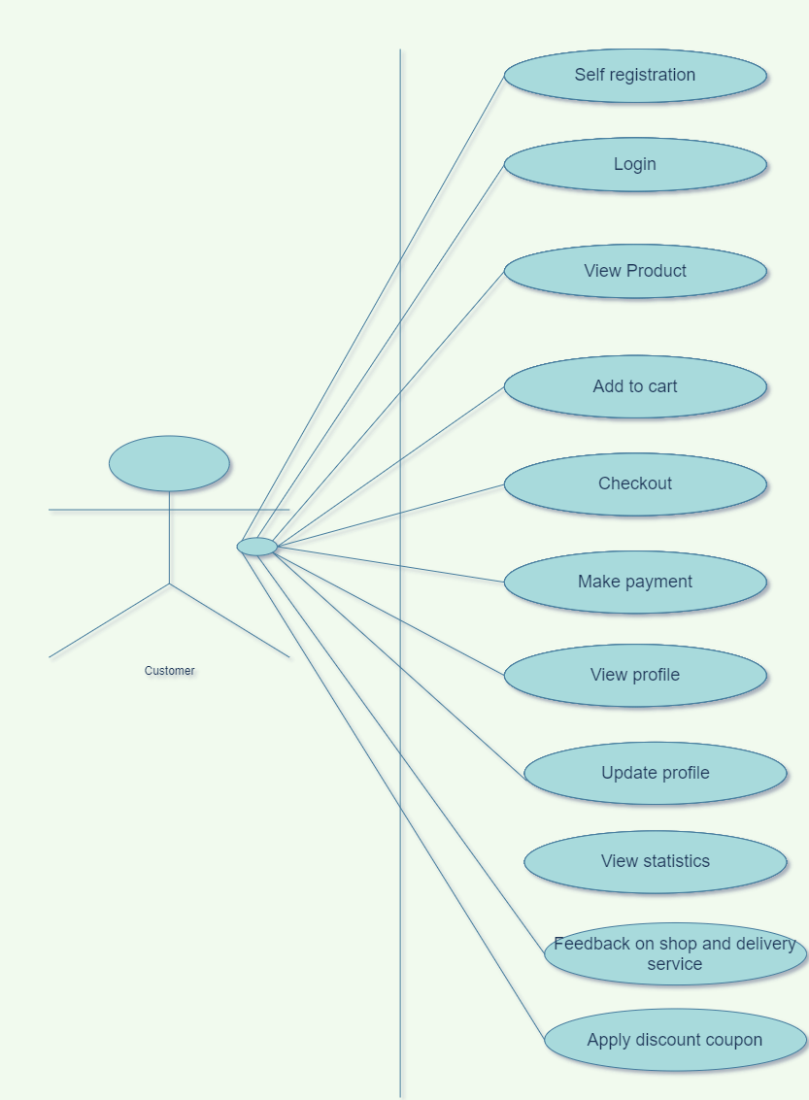
Use Case Diagram
-Customer

Slide 20
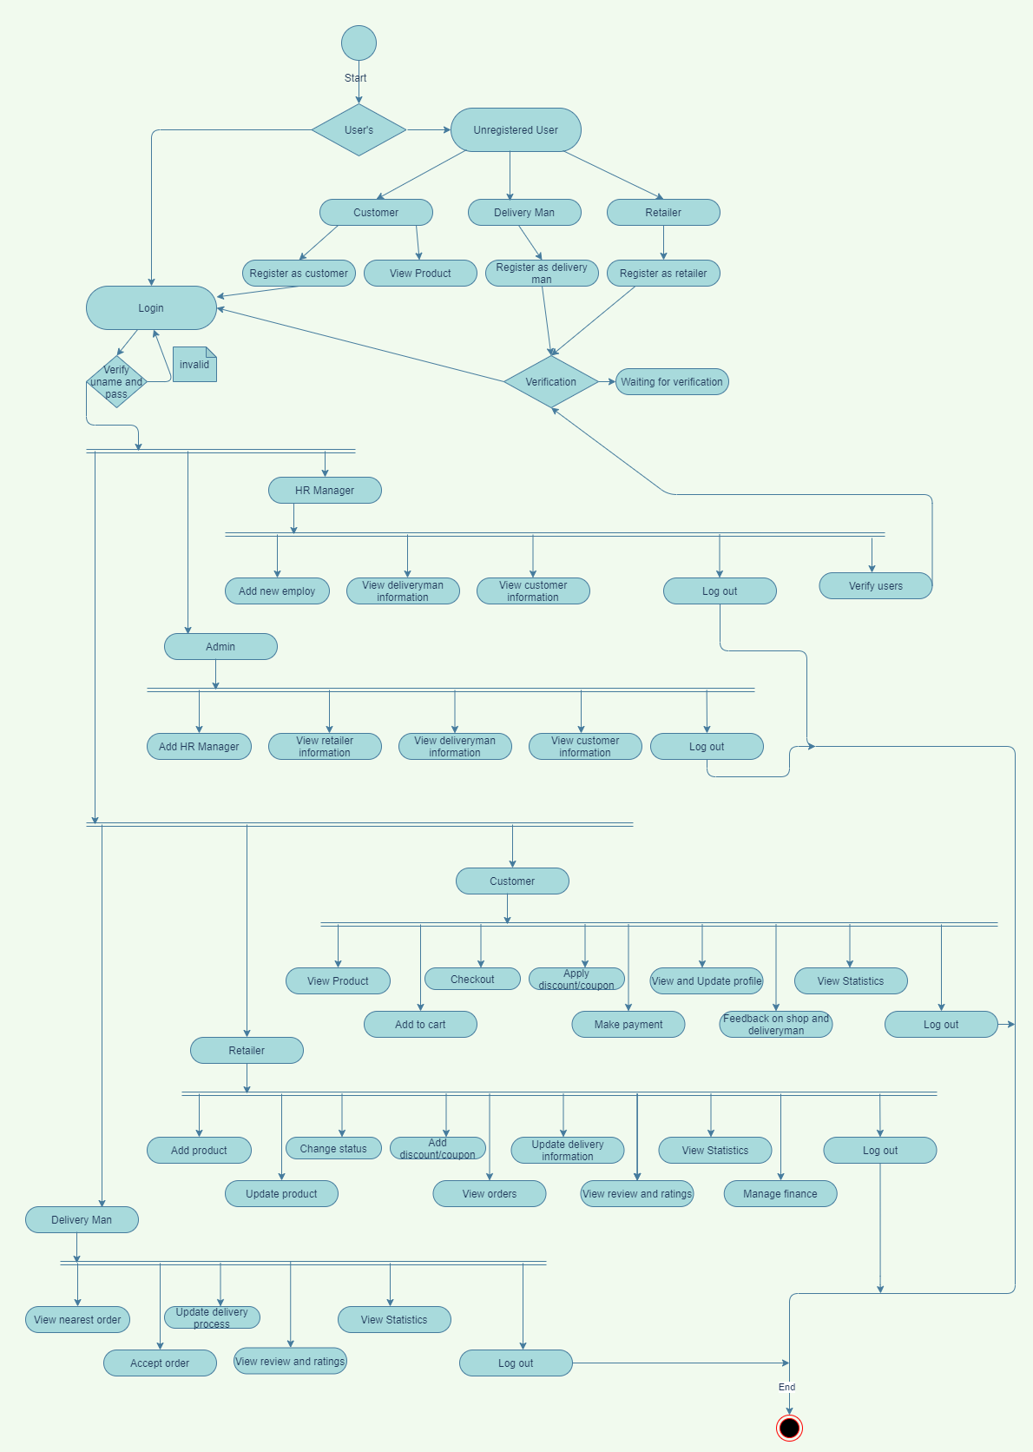
Activity Diagram

Slide 21
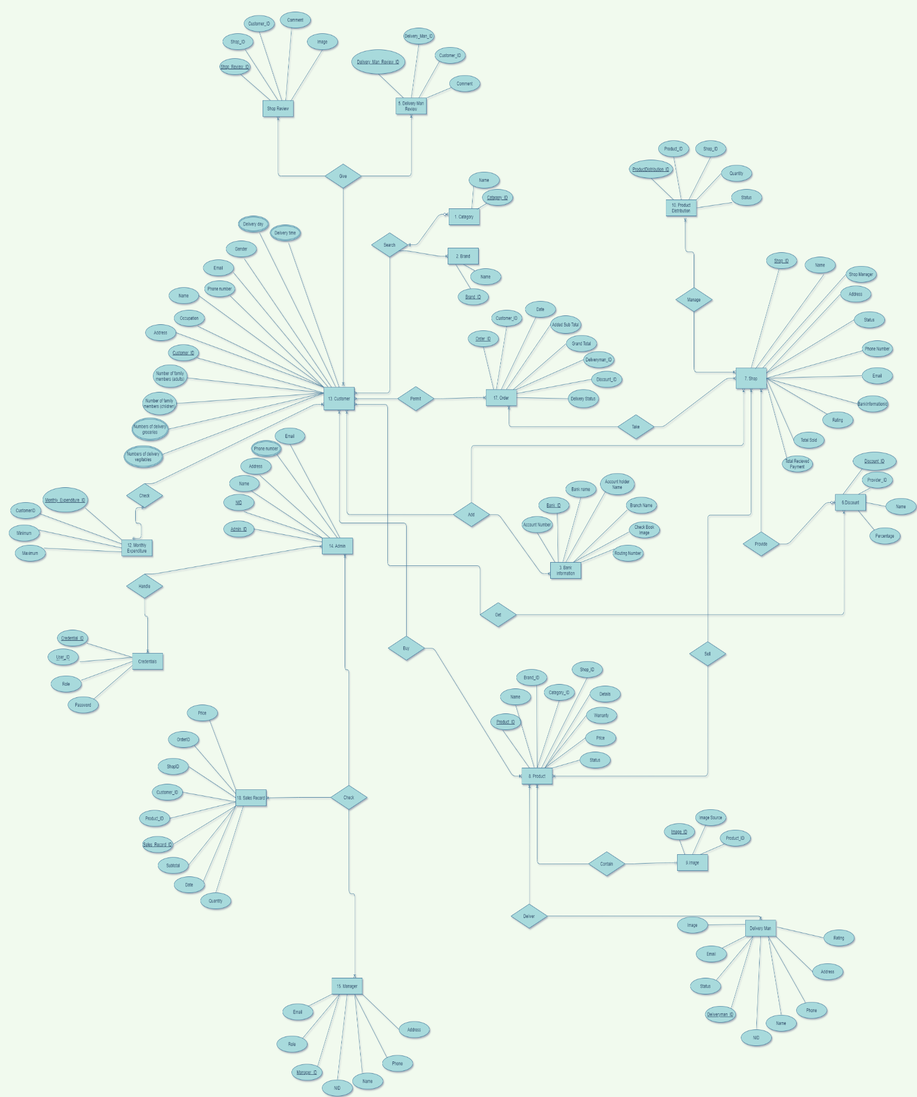
E-R Diagram

Slide 22
Class Diagram

Slide 23
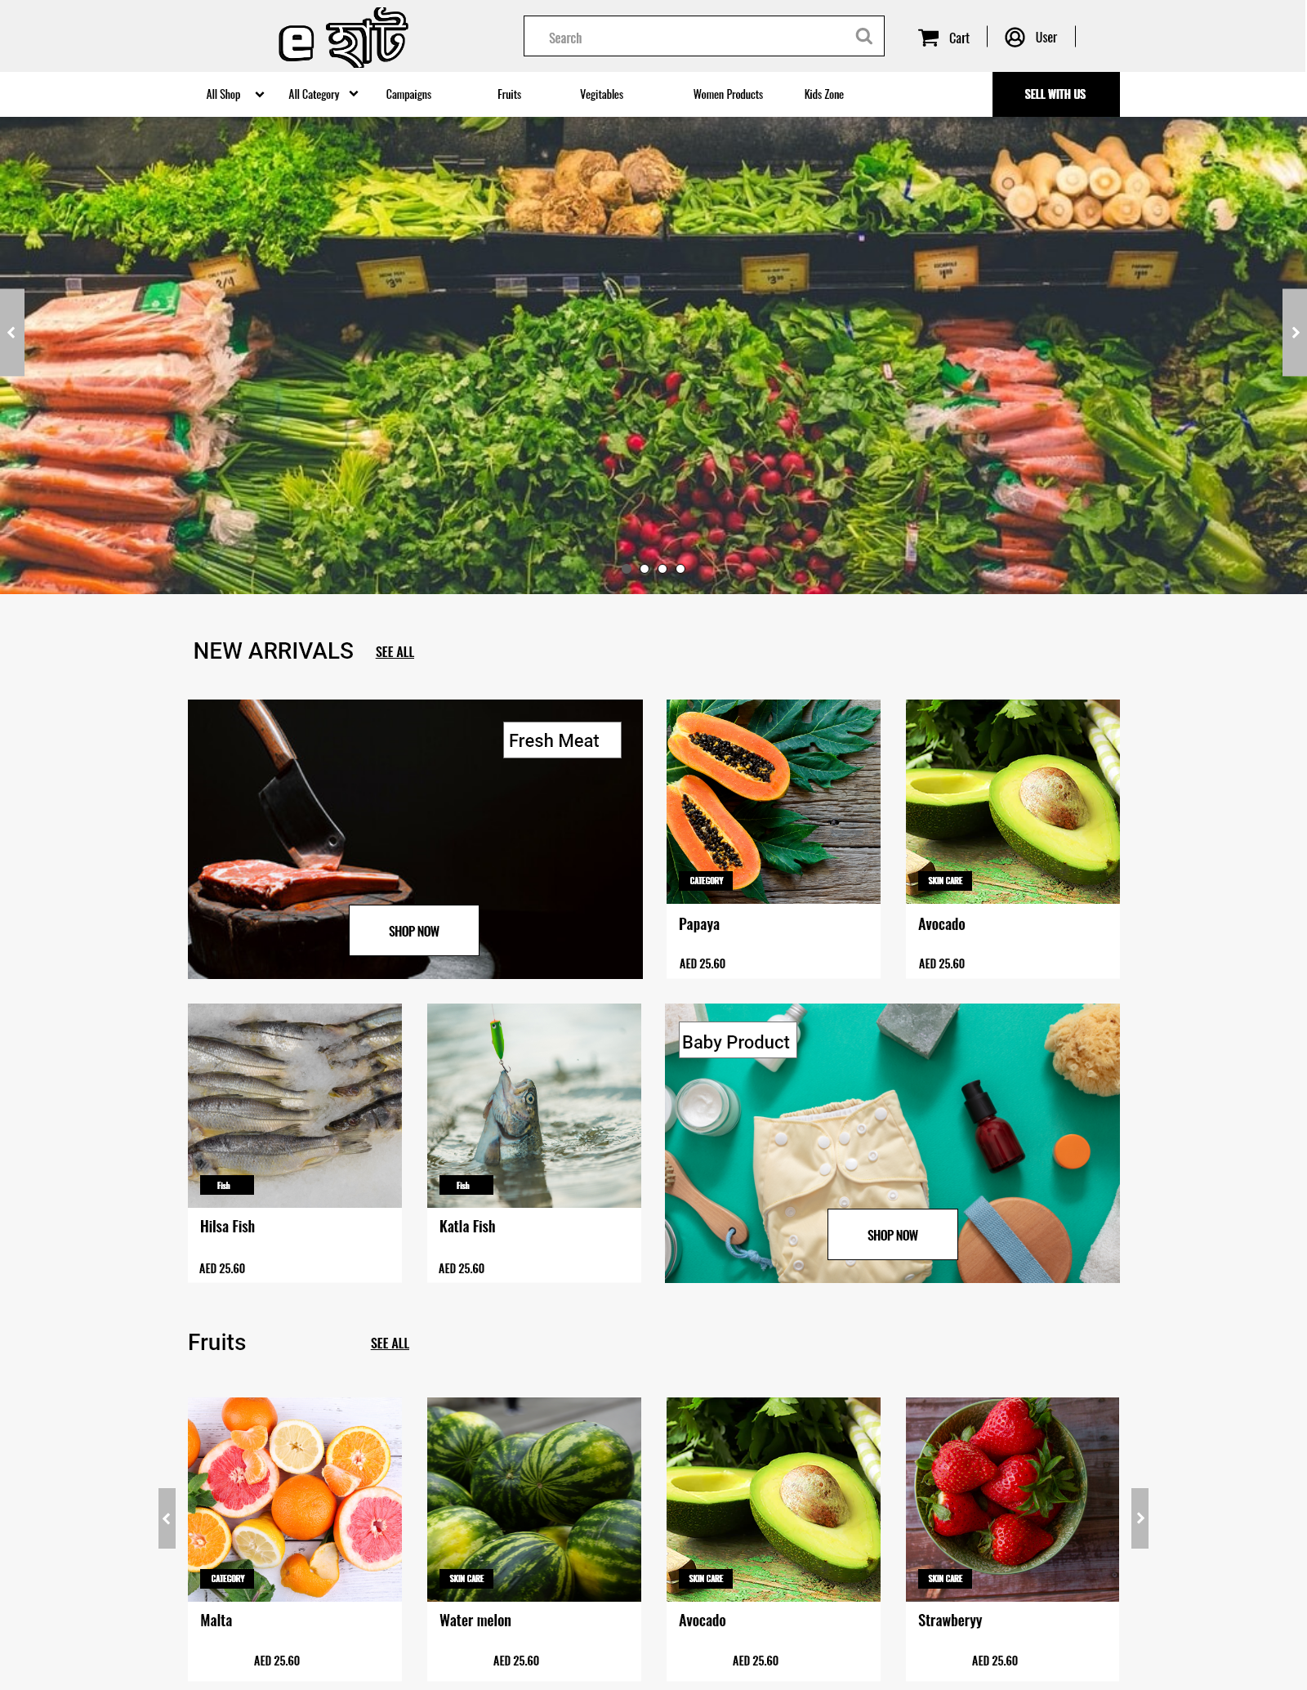
Prototype
-Homepage

Slide 24
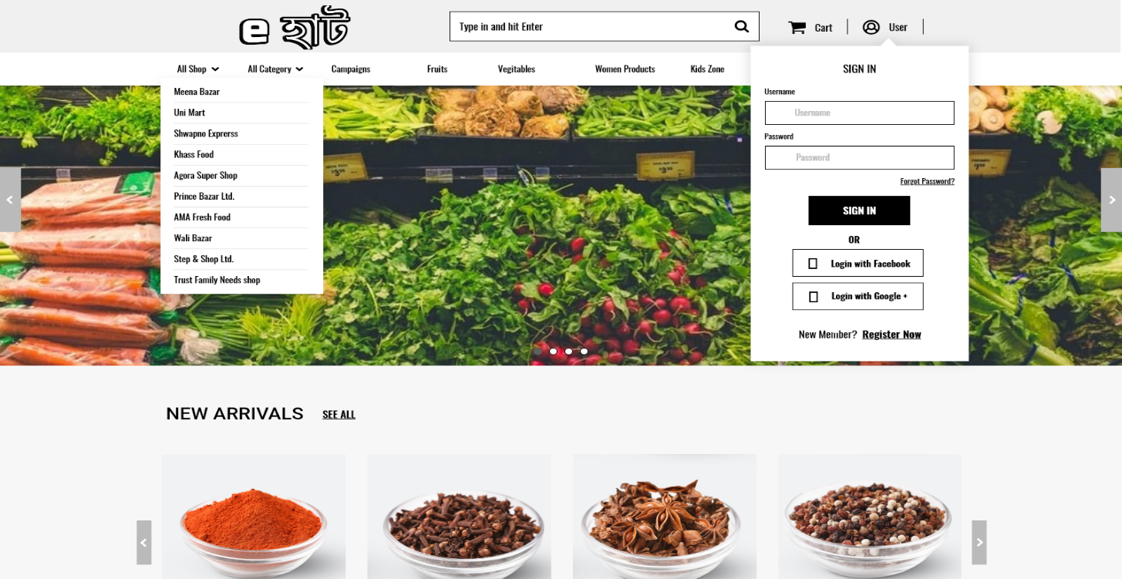
Prototype
-Sign in / Registration

Slide 25
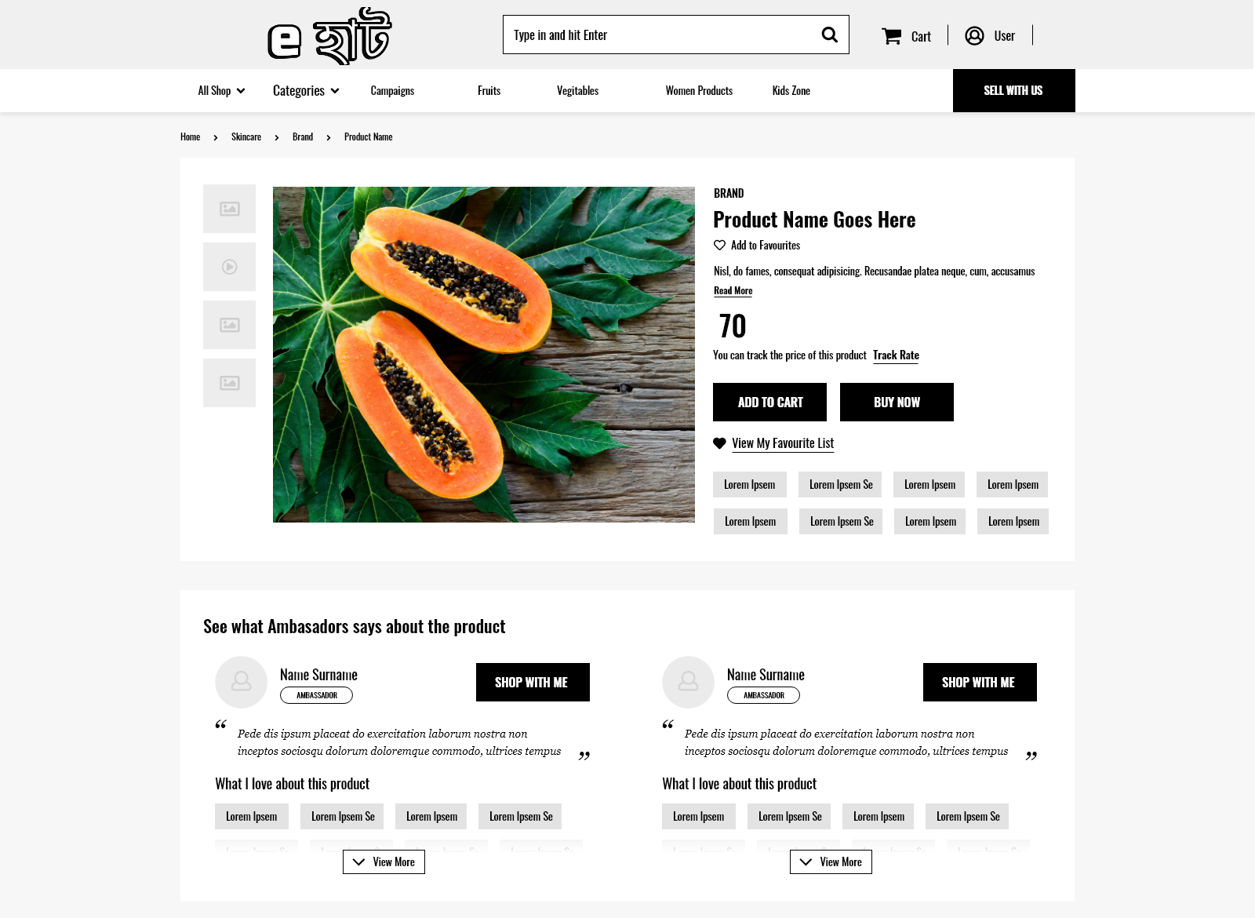
Prototype
-Product Details

Slide 26
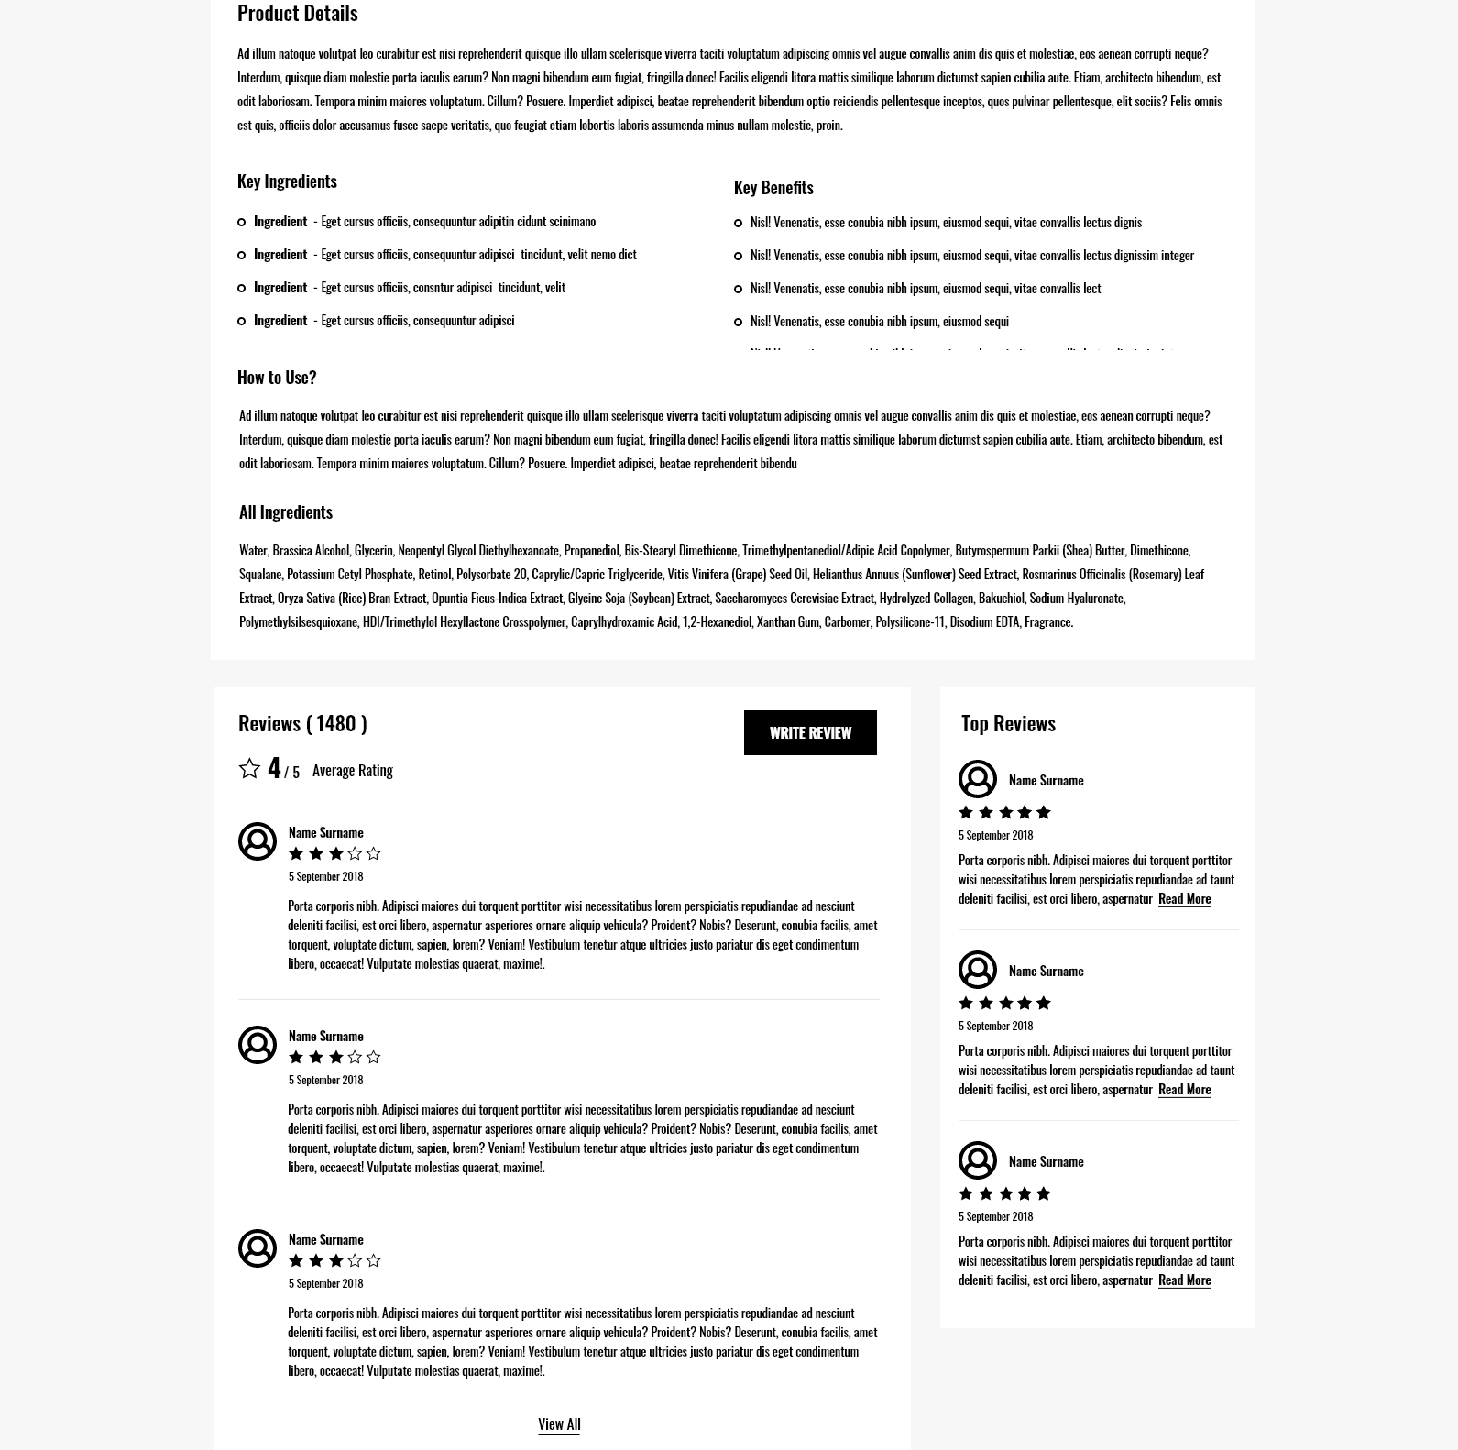
Prototype
-Product Review

Slide 27
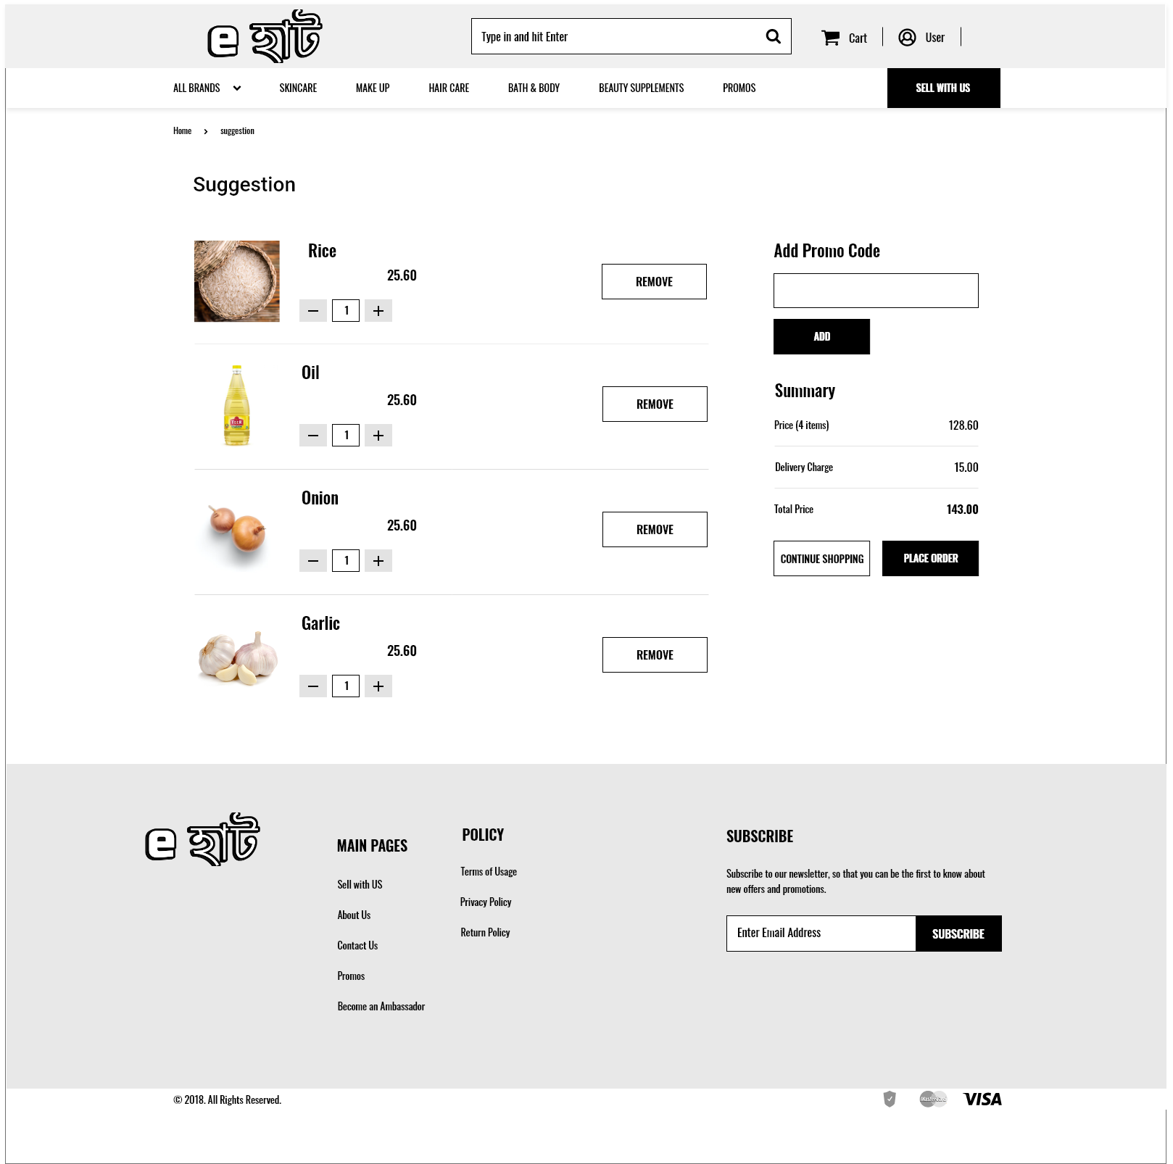
Prototype
-Suggestion Page

Slide 28
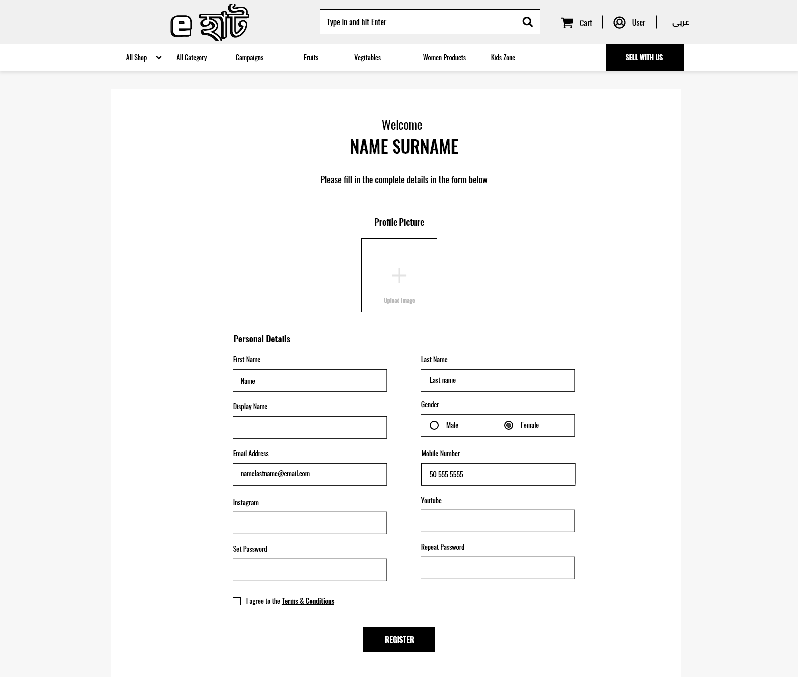
Prototype
-User Registration

Slide 29
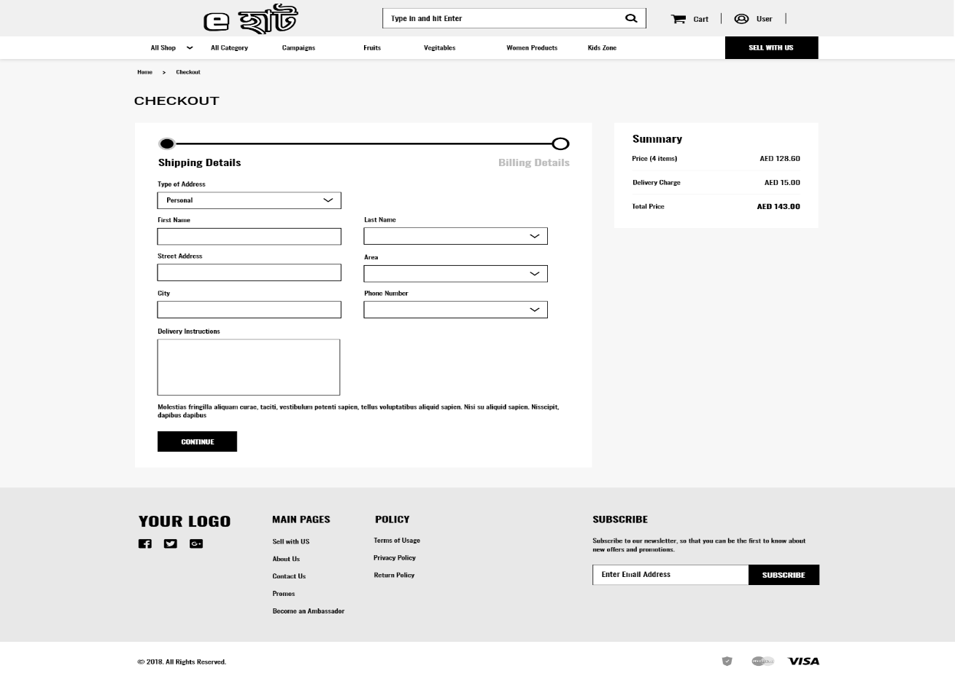
Prototype
-Checkout

Slide 30
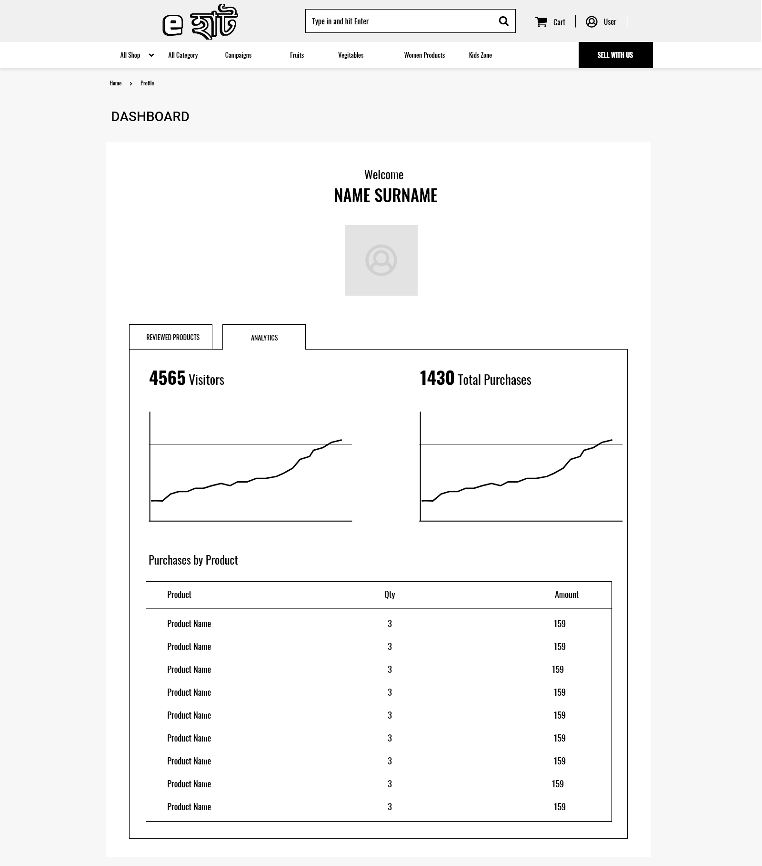
Prototype
-Dashboard

Slide 31
Plannings

Slide 32
Time & Cost
Project Time
Expected time of completion of project is 4 months.
Project Cost
Estimated service cost
Description | Cost Assumption
Resource buying | 20,000BDT
Site launch (hosting) | 45,000 BDT
Maintenance (1 year) | 30,000 BDT
Developers | 3,20,000 BDT
Grand total | 4,15,000 BDT

Slide 33
Risk Management
Risks | Probability | Impact | Rating
Project Manager Availability | 50% | 3 | Medium
Schedule slips | 70% | 4 | Low
Changes in Requirements | 30% | 1 | High
Computer Crash | 20% | 2 | Low
Lack of Development Experience | 30% | 4 | Medium
Programmers doesn’t have good experience | 20% | 1 | Medium
Poor Comments in Code | 40% | 2 | Low
Late delivery | 30% | 4 | Medium
Customer Participation in Beta Testing | 60% | 3 | Medium

Slide 34
Conclusion
This advanced e-commerce project of grocery delivery will definitely help the people in Dhaka city who are really busy in their daily lives.They can be able to save their most valuable time by not going to the groceries physically and also their money as we will work to ensure the best quality products for them.
As this project will be created from scratch, firstly the target will be to complete all the prioritized requirements of the project first.Then it will be tested by following the software testing methologies.After when it will be ready to use, then further development of the project will be approached.

Slide 35
Reference

